Slide 1
CSC207 Phase 0
Tyler’s Gang

Slide 2
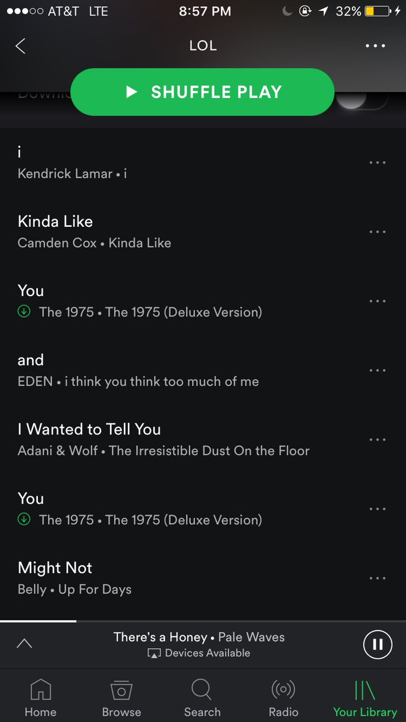
Specification and potential extensions
Entity classes: Playlist, User, Song
Use case classes: UserManager, PlaylistManager, PlaylistGenerator
Controller: ProcessUserInput
and at least a basic command line interface.
Spotify allows the functionality to create ordered playlists to sort and save songs which are then shareable with other users. This then led to people creating playlists where the title of each song creates a sentence.
Our program will generate a playlist (group of songs) based on a string input by the user. These then get assigned to the user’s account and the user can also edit the contents of the playlists.
Potential extensions:
Social functionality
Share, merge and compare playlists
Use web sockets to allow multiple users to write a sentence at the same time!
sortByGenre
Integrating with spotify's playlist functions (title, description, image, etc.)
...

Slide 3
Specification Continued
Running the program starts a text based user input environment that allows the user to input a string to interact with a menu interface
While running, the program prints a menu where users choose from:
Login
If the user chooses to login, the program will read in the user’s username and password before checking if they match with what is stored in the database.
If the username and password match with an account in the database then the user is logged in. Otherwise an error message “username or password invalid” is printed and they are prompted to try again or create a new account
Create new account
If the user chooses to create a new account the program takes inputs of username and password from the user. The program then creates a new user with the above information and stores the new user information on an external database. They are then automatically logged in.
After logging in successfully the program prints a menu where users can choose from:
Create new playlist from string
Manage saved playlists
Account settings
Logout

Slide 4
Specification Continued 2
Create new playlist from string:
If the user wants to create a playlist, they are prompted to enter a string of words which the program then splices in multiple different combinations to be able to find song titles for each word or group of words
Once an array of song names is generated then song entities are created and added to a playlist entity which is then assigned to the user’s account
Manage saved playlists
Once the user has a number of saved playlist they can then edit and manage their playlists, deleting playlists they no longer want and changing the playlist name
Account settings
If the user chooses account settings they can change their username and password
Logout

Slide 5
Entity Classes
User
Username
Password
Stores playlists
(Other account details)
(Friends list)
(Blacklist for songs/albums/artists?)
Playlist
Stores songs
playlistLength → number of songs in the playlist
(compareTo ? → extension with social function)
Song
Name
Artist
(songLength)
(Popularity? → we could use this to find the most popular or listened to songs with each title)
(Genre?)
Explicit or not → could allow users to choose whether or not explicit songs should be included

Slide 6
Use Cases
User Manager
Add and delete users
Get user information
Playlist Manager
Assigns the playlist to the User entity
Adding and deleting songs from the playlist
Playlist Generator
Gets the user inputted string from the controller class in the correct format
Saves song entities from the input string based off the songs in the database / store
- playlistGenerator - “generate playlist” (addSongToPlaylist, deleteSongToPlaylist)
Inputs: array of string generated by controller, user info as a json.
Primary course:
Turn the strings into Songs
Save playlist.

Slide 7
Scenario Walkthrough
The program runs in the MainApp class collaborating with the AppState class that keeps track of how the program is running as well as the View class which deals with the UI and defaults to the homescreen, where the user logs into a text based environment.
They are prompted to either (1) create their account in which case the Authenticator and the UserManager method addUser() adds their details to the database (a .json file for now) and creates a User entity. Otherwise they can (2) login if they are a pre existing user. Their information is processed by the Authenticator class which searches their username and password details from the pre existing .json file using methods checkUserExists() and loginUser(). Once the User is authenticated, the rest of their information, including the Playlist entities and the Song entities within the playlists are instantiated from the .json file (We are not implementing the Authenticator in phase 0, we are assuming each username and password is valid)
Once logged in the user is taken to a separate menu screen where they are able to choose between creating a playlist or managing their old playlist or updating their account details. If they choose to create a playlist they are then prompted to enter a string of words handled by the ProcessUserInput controller class method splitUserInput() which forms an array of song titles. (For phase 0 we are simply splicing the string word for word and using a file of song information for testing purposes. In the final version the splicing is more complex) The formatted song information is then sent to the PlaylistGenerator and then to SongGenerator classes which accesses information from a .json file to instantiates the Song entities using the method generateSong(), and each Song is added to the newly instantiated Playlist entity. The PlaylistManager allows you to add and delete song entities from the list through the methods addSong() and deleteSong() by typing in the song name. Finally the user can also logout from the homescreen with the logoutUser() method.

Slide 8
Entity CRC
Name: User
Methods/Applications: getUsername() getPassword() getPlaylistList() updatePlaylistList() getFriendsList() setBlacklist() getSongBlacklist() | Collaborator: Playlist
Name: Song
Methods/Applications: getName() getDuration() getArtist() getAlbum() getGenre() isExplicit() getPopularity() | Collaborator: Playlist
Name: Playlist
Methods/Applications: getSongAtIndex() getPlaylistName() setPlaylistName() getPlaylistLength() addSong(song) | Collaborator: Song
Notes:
Can we put a specific type (e.g. Playlist) as a parameter?

Slide 9
Use Cases CRC
Name: UserManager
Methods/Applications: addUser() deleteUser() getUser() | Collaborator: User Authenticator
Name: PlaylistManager
Methods/Applications: checkOrder() addPlaylist(Playlist, User) removePlaylist(Playlist, User) | Collaborator: Playlist User
Name: PlaylistGenerator
Methods/Applications: generatePlaylist() | Collaborator: Playlist Song
Name: SongGenerator
Methods/Applications: CSVReader generateSong() | Collaborator: Playlist

Slide 10
Controller CRC
Name: ProcessUserInput
Methods/Applications: splitUserInput() | Collaborator: PlaylistManager
Name: Authenticator
Methods/Applications: loginUser() logoutUser() isLoggedIn() checkUserExists() registerUser() | Collaborator: UserManager

Slide 11
Frameworks and Driver CRC
Name: AppState
Methods/Applications: isRunning() stopRunning() getCurrView changeCurView() | Collaborator: View
Name: StateChanger
Methods/Applications: changeState() | Collaborator: AppState
Name: MainApp (Responsibility: To run and terminate the program. Provide access to other classes.)
Methods/Applications: main() | Collaborator: AppState StateChanger
Name: View (abstract) (Responsibility: The parent class for the view objects the program can be in.)
Methods/Applications: getHeader() getMenuOptions() getFooter() isMenuView() | Collaborator: AppState StateChanger MainApp

